Slide 1
Data Visualizations
3 Best and 3 Worst Examples
Etana Disasa
College of Computer & Information Sciences
Regis University

Slide 2
Introduction
This presentation attempts to showcase three best and three worst data visualization examples.
Several factors such as simplicity, visibility, labeling and more are discussed.
These discussed points are also included in the notes of each slide.

Slide 3

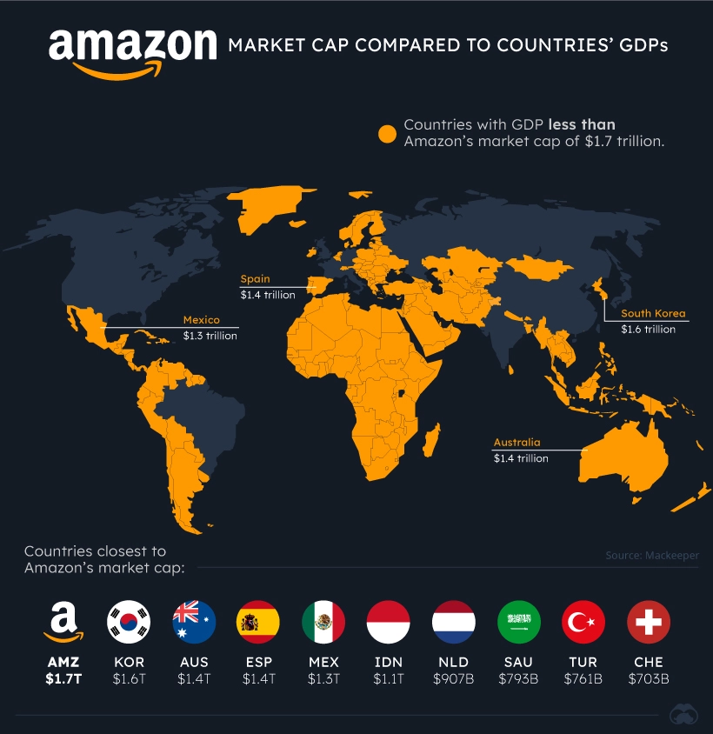
Best Data Visualization: One
SOURCE: https://www.visualcapitalist.com/the-tech-giants-worth-compared-economies-countries/
Notes:
This geographical data visualization I found was very effective. The full image is included in the next slide.

Slide 4
Best Data Visualization: One
Simplicity
This presentation is very simple. Anyone with a functional relationship with the map of the world would be able to understand what countries are included in the yellow, and in the gray shades.
Clarity
Furthermore, the title, the key and description offer more clarity to what information is being communicated.
SOURCE: https://www.visualcapitalist.com/the-tech-giants-worth-compared-economies-countries/
Notes:
Simplicity
This presentation is very simple. Anyone with a functional relationship with the map of the world would be able to understand what countries are included in the yellow, and in the gray shades.
Clarity
Furthermore, the title, the key and description offer more clarity to what information is being communicated.

Slide 5
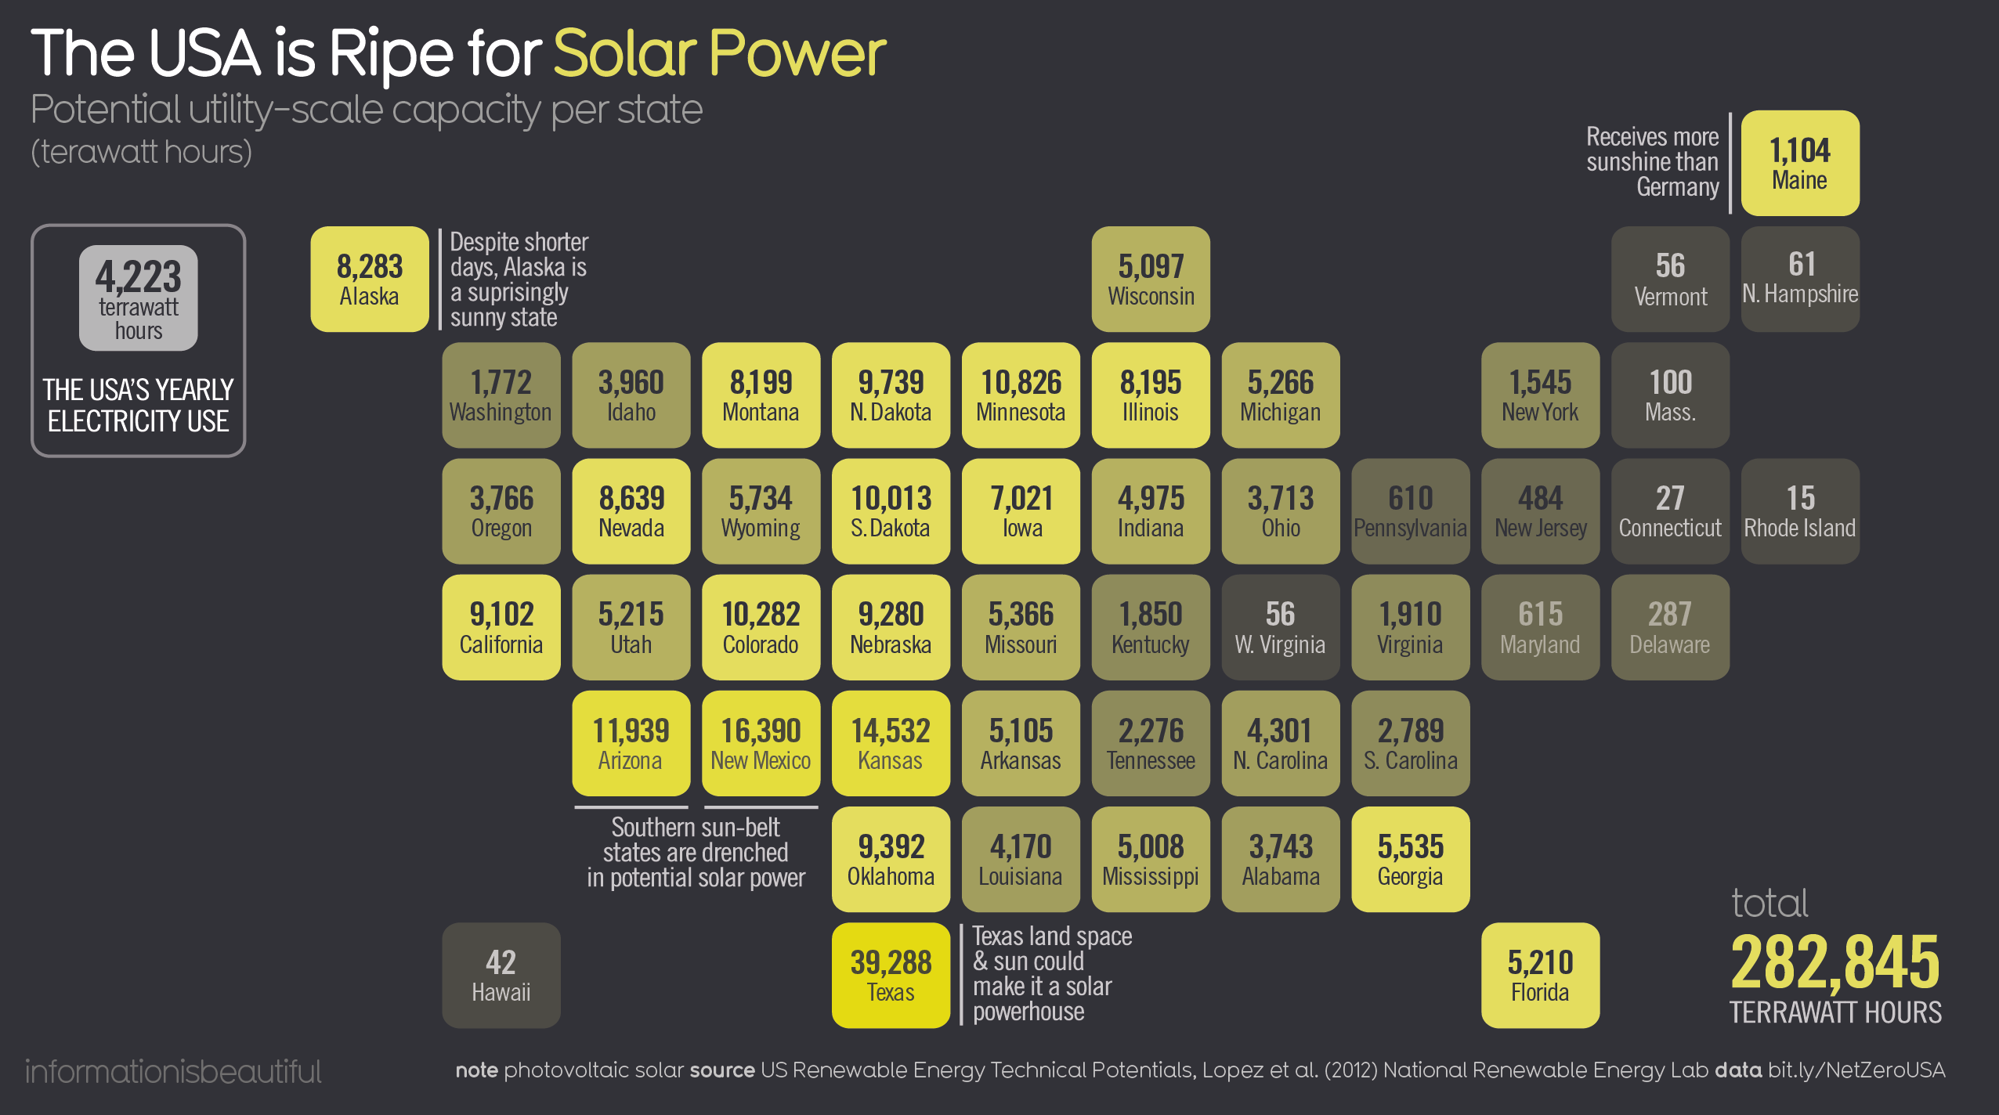
Best Data Visualization: Two
SOURCE: https://informationisbeautiful.net/visualizations/how-to-get-the-usa-to-carbon-netzero/
Notes:
SOURCE: https://www.visualcapitalist.com/the-tech-giants-worth-compared-economies-countries/

Slide 6
Best Data Visualization: Two
Color Code
In a spectrum from dimmer to bright yellow, the color shades represent potential solar power production per state, low to high.
Simplified
This presentation addresses the difficulty of visualizing states that are either small on the map or scattered out by tabulating the map.
SOURCE: https://informationisbeautiful.net/visualizations/how-to-get-the-usa-to-carbon-netzero/
Notes:
Color Code
In a spectrum from dimmer to bright yellow, the color shades represent potential solar power production per state, low to high. Supplemental information and comparison are also displayed.
Simplified
This presentation addresses the difficulty of visualizing states that are either small on the map or scattered out by tabulating the map.

Slide 7

Best Data Visualization: Three
SOURCE: https://www.informationisbeautiful.net/visualizations/non-fiction-books-everyone-should-read-interactive/

Slide 8
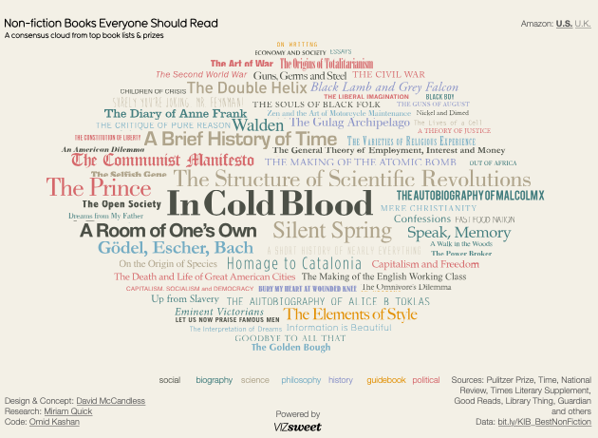
Best Data Visualization: Three
Visually Considerate
This word cloud is an interactive data visualization for non-fiction books recommended. Each color represents different genres. The color selection is used conservatively; meaning, it is not disturbing in particular to a more mature viewer. There were also several different font-faces so that titles can be seen clearly.
Function
Furthermore, each book title is hyperlinked so viewers can be directed to where they can buy these books.
Notes:
Visually Considerate
This word cloud is an interactive data visualization for non-fiction books recommended. Each color represents different genres. The color selection is used conservatively; meaning, it is not disturbing in particular to a more mature viewer. There were also several different font-faces so that titles can be seen clearly.
Function
Furthermore, each book title is hyperlinked so viewers can be directed to where they can buy these books.

Slide 9
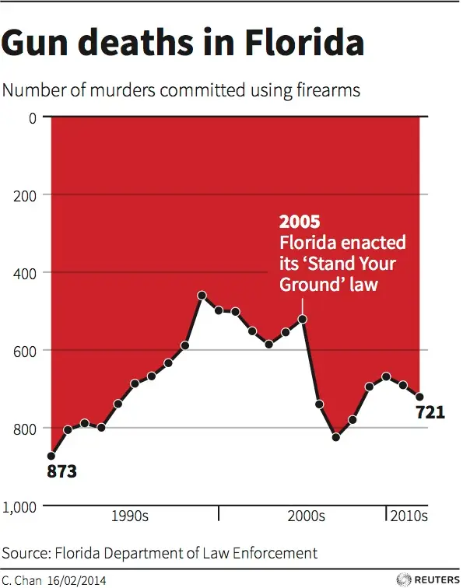
Worst Data Visualization: One
SOURCE: https://www.businessinsider.com/gun-deaths-in-florida-increased-with-stand-your-ground-2014-2?op=1

Slide 10
Worst Data Visualization: One
Misleading
This graph’s y-axis, for whatever reason, was labeled upside down. Unlike the convention, the chart is upside down—showing an increase in gun death upside-down; meaning, the observation going down actually means, up.
SOURCE: https://www.businessinsider.com/gun-deaths-in-florida-increased-with-stand-your-ground-2014-2?op=1
Notes:
Misleading
This graph’s y-axis, for whatever reason, was labeled upside down. Unlike the convention, the chart is upside down—showing an increase in gun death upside-down; meaning, the observation going down actually means, up.

Slide 11

Worst Data Visualization: Two
SOURCE: https://vimeo.com/45658298?embedded=true&source=video_title&owner=12513236
Notes:
https://vimeo.com/45658298?embedded=true&source=video_title&owner=12513236

Slide 12
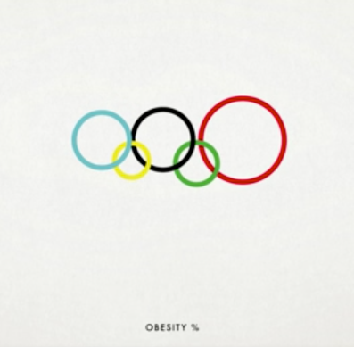
Worst Data Visualization: Two
Labeling
This visualization utilizes the Olympic rings to visualize different observations in five different continents. How do I know that? The title of the video which is “oceaniaeuropeamericasafricaasia“. Obesity, Gun Ownership, McDonald’s Outlet, Population, CO₂ Emissions Per Capita, Homicides and others were the observations where the rings grow up and shrink down to showcase the values. However, nowhere in this video the creator labels the circles. I had to learn about it from the comments section where viewers were sharing this challenge of understanding the visualization.
Notes:
Labeling
This visualization utilizes the Olympic rings to visualize different observations in five different continents. How do I know that? The title of the video which is “oceaniaeuropeamericasafricaasia“. Obesity, Gun Ownership, McDonald’s Outlet, Population, CO₂ Emissions Per Capita, Homicides and others were the observations where the rings grow up and shrink down to showcase the values. However, nowhere in this video the creator labels the circles. I had to learn about it from the comments section where viewers were sharing this challenge of understanding the visualization.

Slide 13
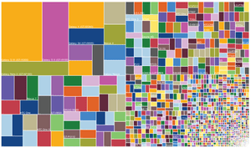
Worst Data Visualization: Three
SOURCE: https://www.theguardian.com/news/datablog/gallery/2013/aug/01/16-useless-infographics

Slide 14
Worst Data Visualization: Three
Visibility
This treemap shows “how when an android phone is released, lots of different versions can spin off it.”¹ However, the colors and the number of observations has made it impossible to understand what is being communicated.
The main reason data visualization is important is to communicate information that would otherwise will be difficult to understand. This treemap doesn’t appear to be a good tool.
1. Mona Chalabi, “16 Useless Infographics | News | The Guardian,” accessed September 1, 2022, https://www.theguardian.com/news/datablog/gallery/2013/aug/01/16-useless-infographics.
Notes:
Visibility
This treemap shows “how when an android phone is released, lots of different versions can spin off it.”¹ However, the colors and the number of observations has made it impossible to understand what is being communicated.
The main reason data visualization is important is to communicate information that would otherwise will be difficult to understand. This treemap doesn’t appear to be a good tool.

Slide 15
Summary
Visibility was one of the factors that came up multiple times during this presentation.
This includes the colors used in the visualization tools, font-faces, labeling and other factors contribute to whether viewers would be able to understand the information.
Furthermore, choosing visualization tool to appropriately showcase information would be key. Every tool is not necessarily the right tool for the data that is being used.
Finally, simplicity is one other factor that makes visualization intelligible.

Slide 16
Resources
References
Chalabi, Mona. “16 Useless Infographics | News | The Guardian.” Accessed September 1, 2022. https://www.theguardian.com/news/datablog/gallery/2013/aug/01/16-useless-infographics.
Sources
https://www.theguardian.com/news/datablog/gallery/2013/aug/01/16-useless-infographics
https://vimeo.com/45658298?embedded=true&source=video_title&owner=12513236
https://www.businessinsider.com/gun-deaths-in-florida-increased-with-stand-your-ground-2014-2?op=1
https://www.informationisbeautiful.net/visualizations/non-fiction-books-everyone-should-read-interactive/
https://informationisbeautiful.net/visualizations/how-to-get-the-usa-to-carbon-netzero/
https://www.visualcapitalist.com/the-tech-giants-worth-compared-economies-countries/

